Slide 1
Leak Test 2:
Sl no. | Time elapsed (in min) | Pressure (in mbar)
1. | 3.24 | 2.359
2. | 5.32 | 4.135
3. | 7.24 | 2.851
In slide 2 to 4 you can see that even after 7 min of vacuum pump run, its unable to create a vacuum detectable in pirani gauge!!!
This a deposition system which need a good vacuum hold in pirani gauge region. We are not interested in membrane gauge vacuum region.
In other experiment, Pressure drops from 0.02 mbar to pirani undetectable region (pressure >1 mbar) in 2-3 seconds.
In Slide 5, you can see that the pressure drops below -8 psi from -14.4 psi in just 4.30 hours indicating there must be a leak.

Slide 2
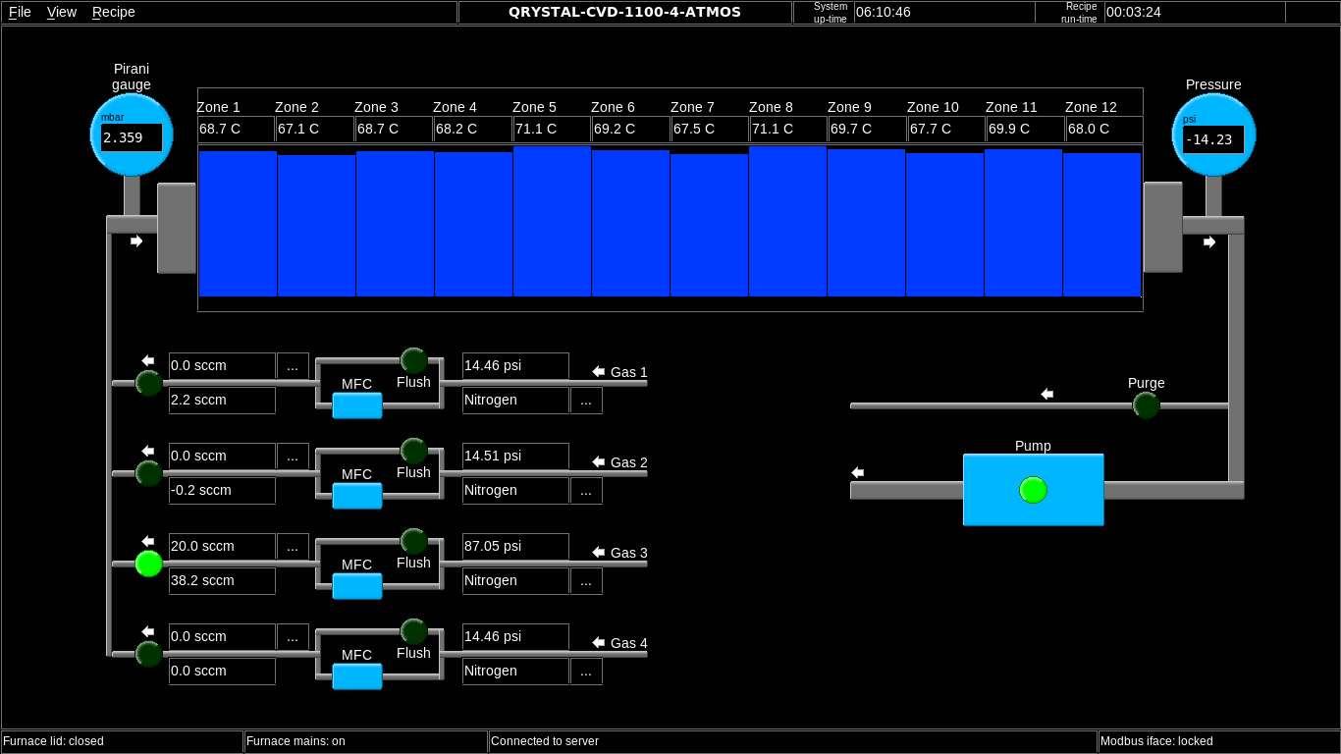
MFC (Channel 2) & Vacuum Pump: Not working properly

Slide 3
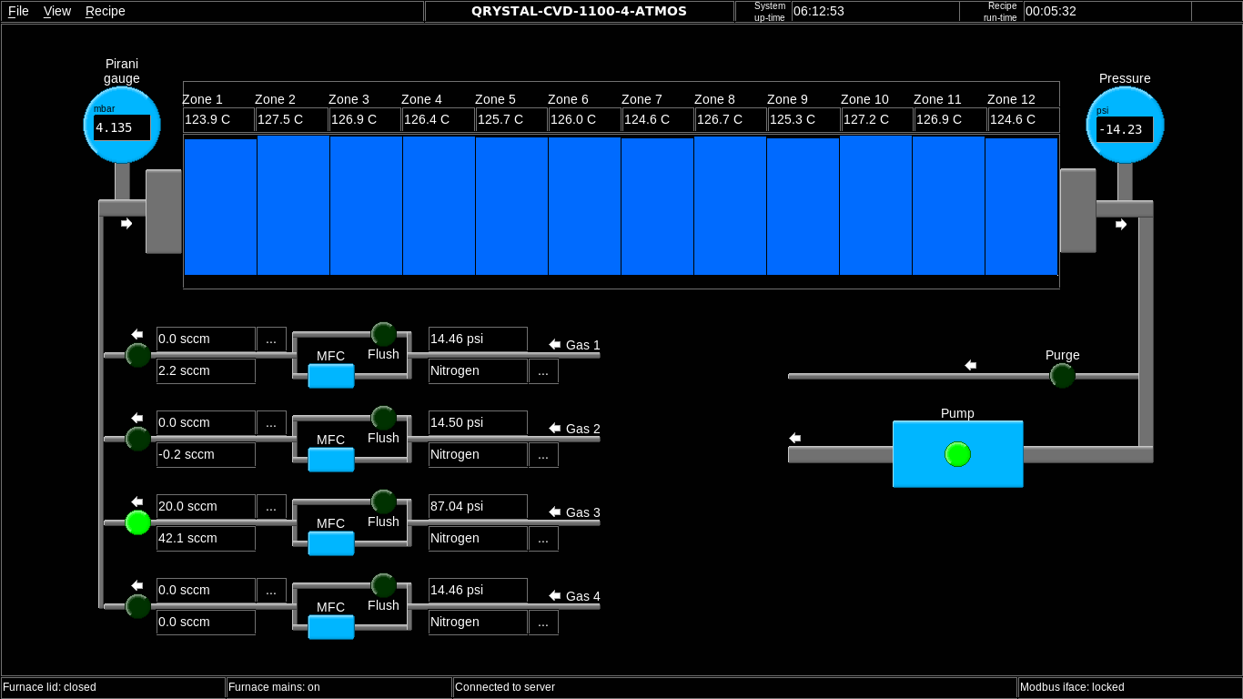

Slide 4
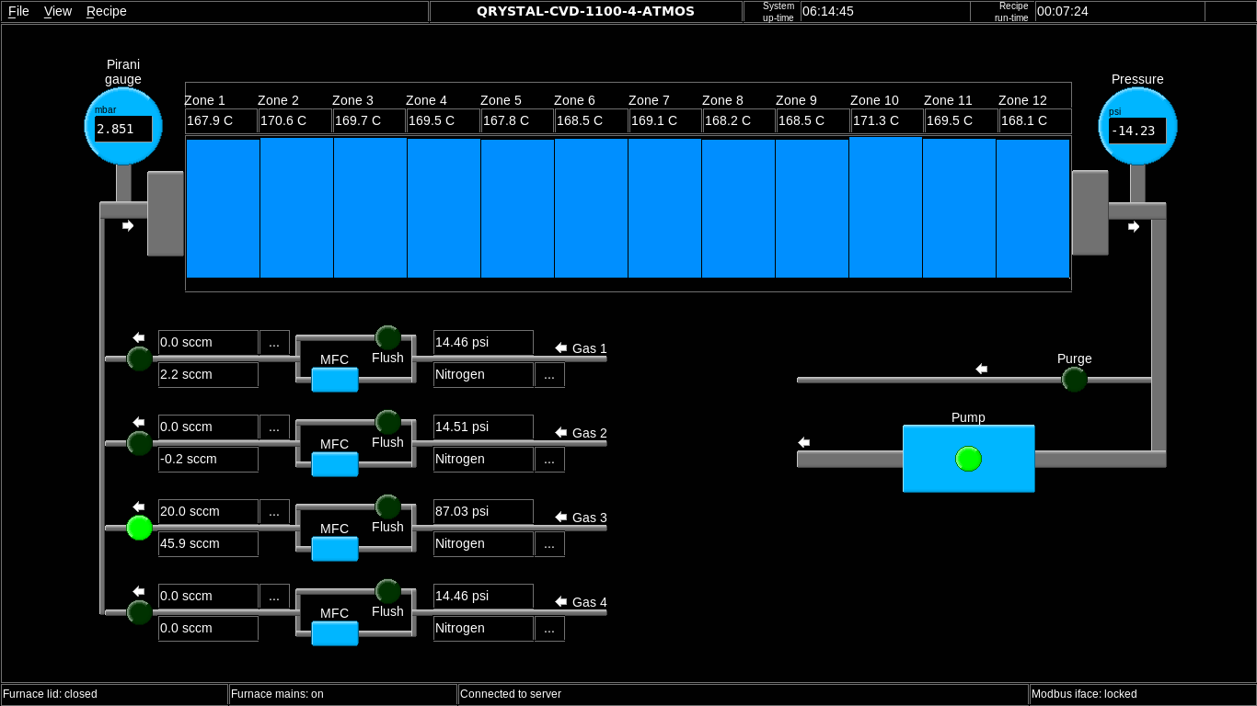

Slide 5
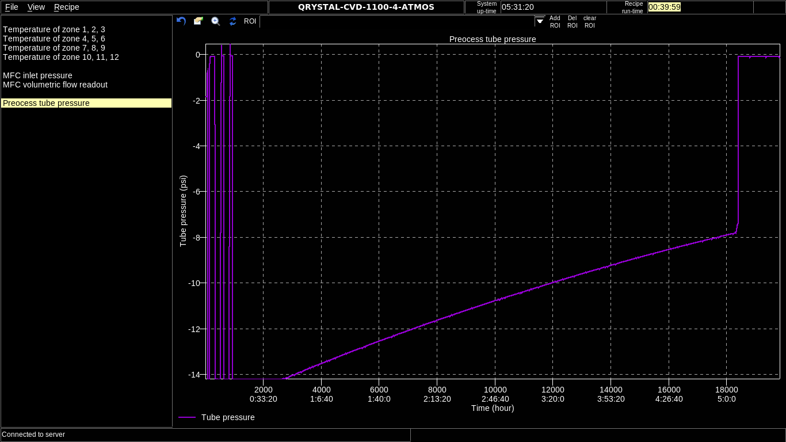
Pressure Profile
Pressure drops from 0.03 mbar to atmospheric pressure (>1.xx mbar) in less than 5 seconds.

Slide 6
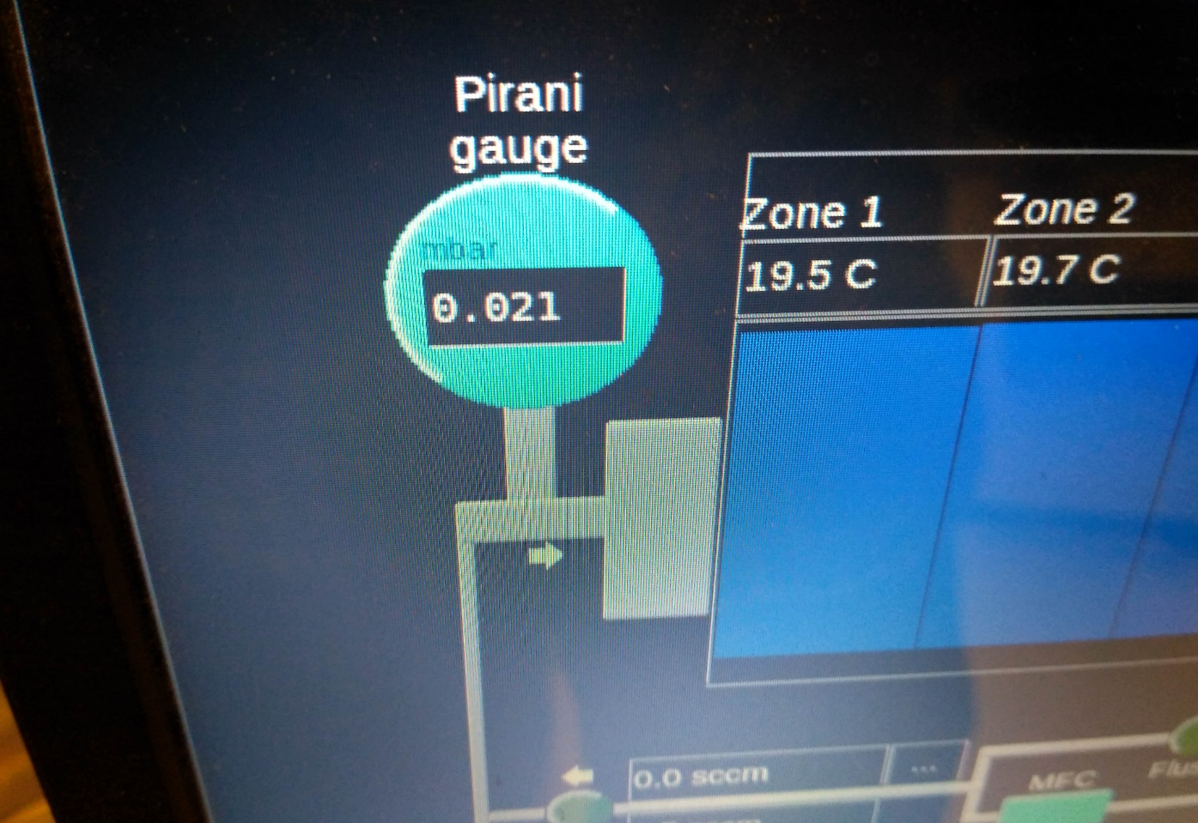
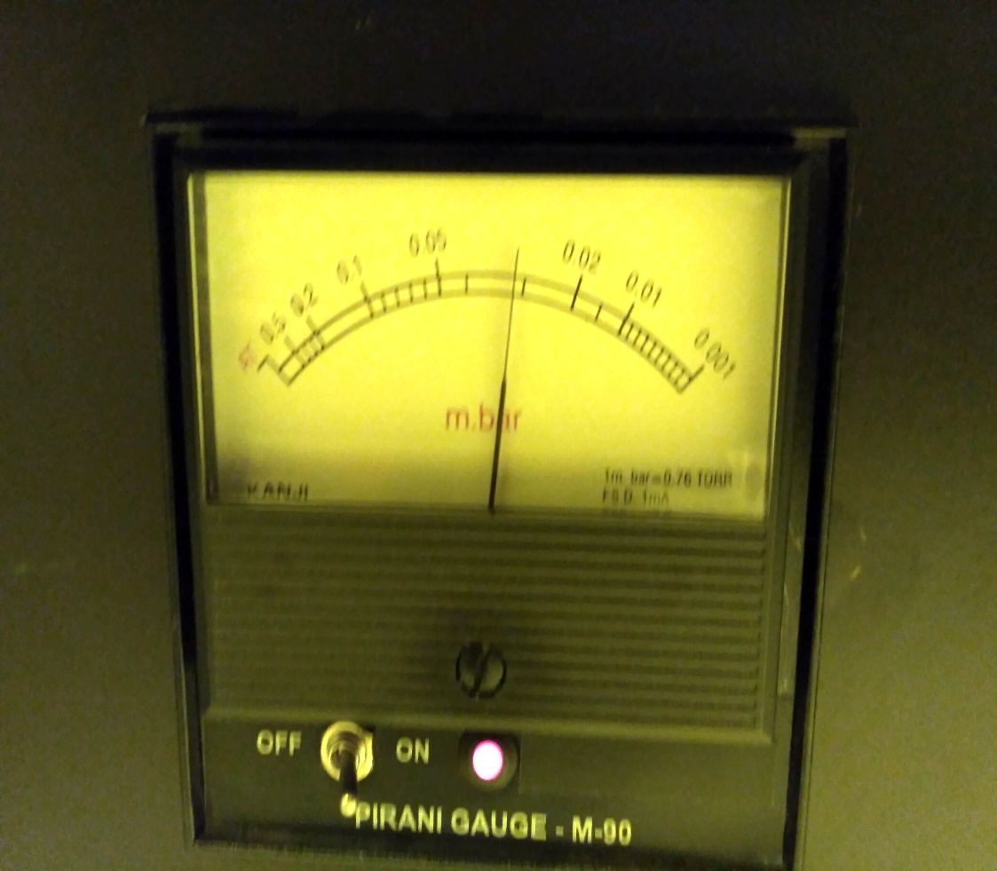
Pressure reading difference between analog & digital pirani gauge

Slide 7
Leak Test
Plastic O-rings
Metallic joints that holds the O-rings with the tube.

Slide 8
Other things to consider…
One way purge valve.
Preview window.
Command to abort a recipe (Needs an updated one)
Vacuum pump works occasionally.

